Slide 1
IBM University Engagement Project Submission
“Exploring the Power of Machine Learning with IBM Cloud”

Slide 2


Project Title – [Audio Signal Processing Agent]
Domain of Project – [Electronics and Telecommunications Engineering]
Student Name | Recent Passport Photo | Email ID | Mobile number [WhatsApp]
Niraj kumar |  | Neeraj91937@gmail.com | +917857001726

Slide 3
Problem Statement
Problem Statement:– Audio Signal Processing Assistant Agent
Audio signal processing is a critical part of electronics, communication systems, and multimedia applications. Engineers and students frequently encounter problems such as amplifier noise, audio distortion, grounding issues, signal attenuation, filter design errors, impedance mismatch, and unstable op-amp circuits. Diagnosing these problems requires technical expertise and significant troubleshooting time.
This project proposes an AI-powered Audio Signal Processing Assistant that uses IBM Granite AI to analyze user queries related to audio circuits and provide intelligent recommendations. The assistant helps users identify the root cause of circuit problems, suggests suitable filter designs, recommends grounding techniques, and provides practical solutions for improving audio quality. The system reduces troubleshooting time and serves as an intelligent technical assistant for students, hobbyists, and engineers.

Slide 4
Proposed Solution -
The proposed solution is an AI-powered Audio Signal Processing Assistant developed using IBM watsonx.ai, IBM Granite Foundation Models, Python Flask, and IBM Cloud.
The assistant receives user questions related to audio circuits and signal processing. IBM Granite AI understands the technical query, analyzes the circuit problem, and generates intelligent recommendations.
The system provides:
Audio amplifier troubleshooting
Noise reduction techniques
Active and passive filter recommendations
Ground loop analysis
Distortion analysis
Op-Amp circuit guidance
Audio circuit optimization
Component selection assistance
The application provides a simple web interface where users receive AI-generated technical guidance instantly.

Slide 5
Technology Used
IBM Cloud
Provides cloud infrastructure for hosting AI services.
IBM watsonx.ai
Used to access IBM Granite foundation models.
IBM Granite 3.3 8B Instruct
Processes engineering queries and generates technical solutions.
Python Flask
Developed the web application backend.
HTML, CSS, JavaScript
Developed the user interface.
GitHub
Version control and project repository.

Slide 6
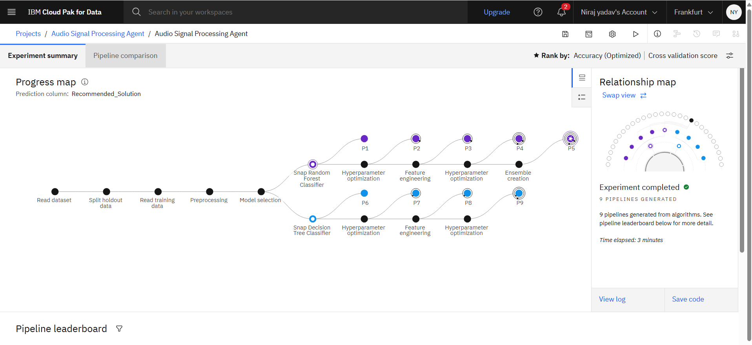
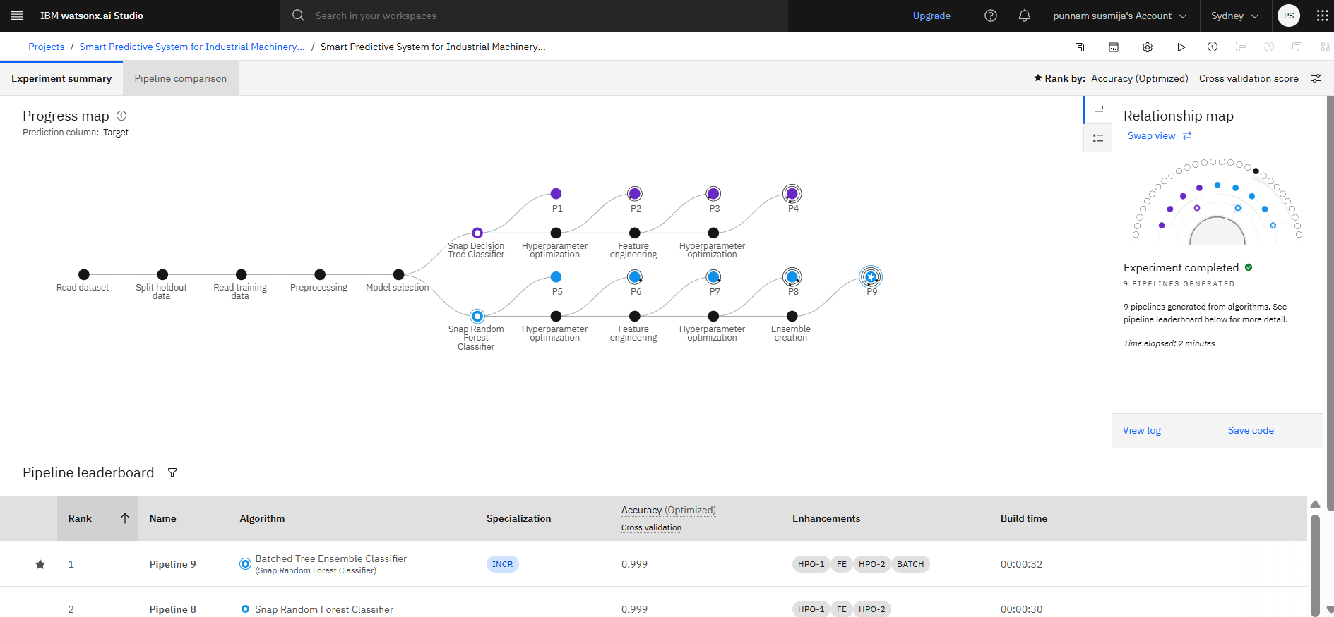
Training Screenshots-

Slide 7
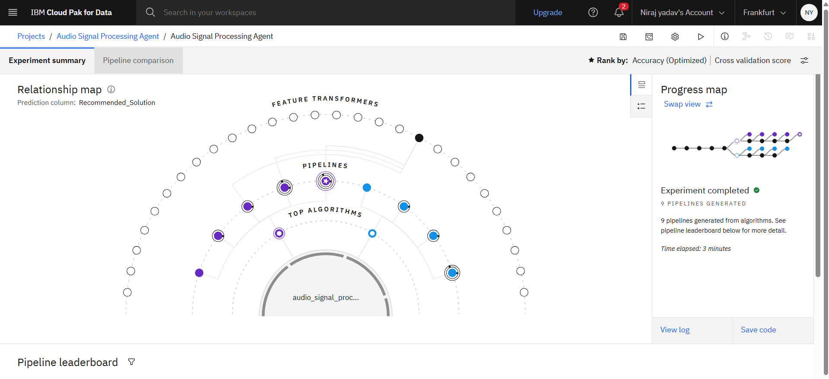
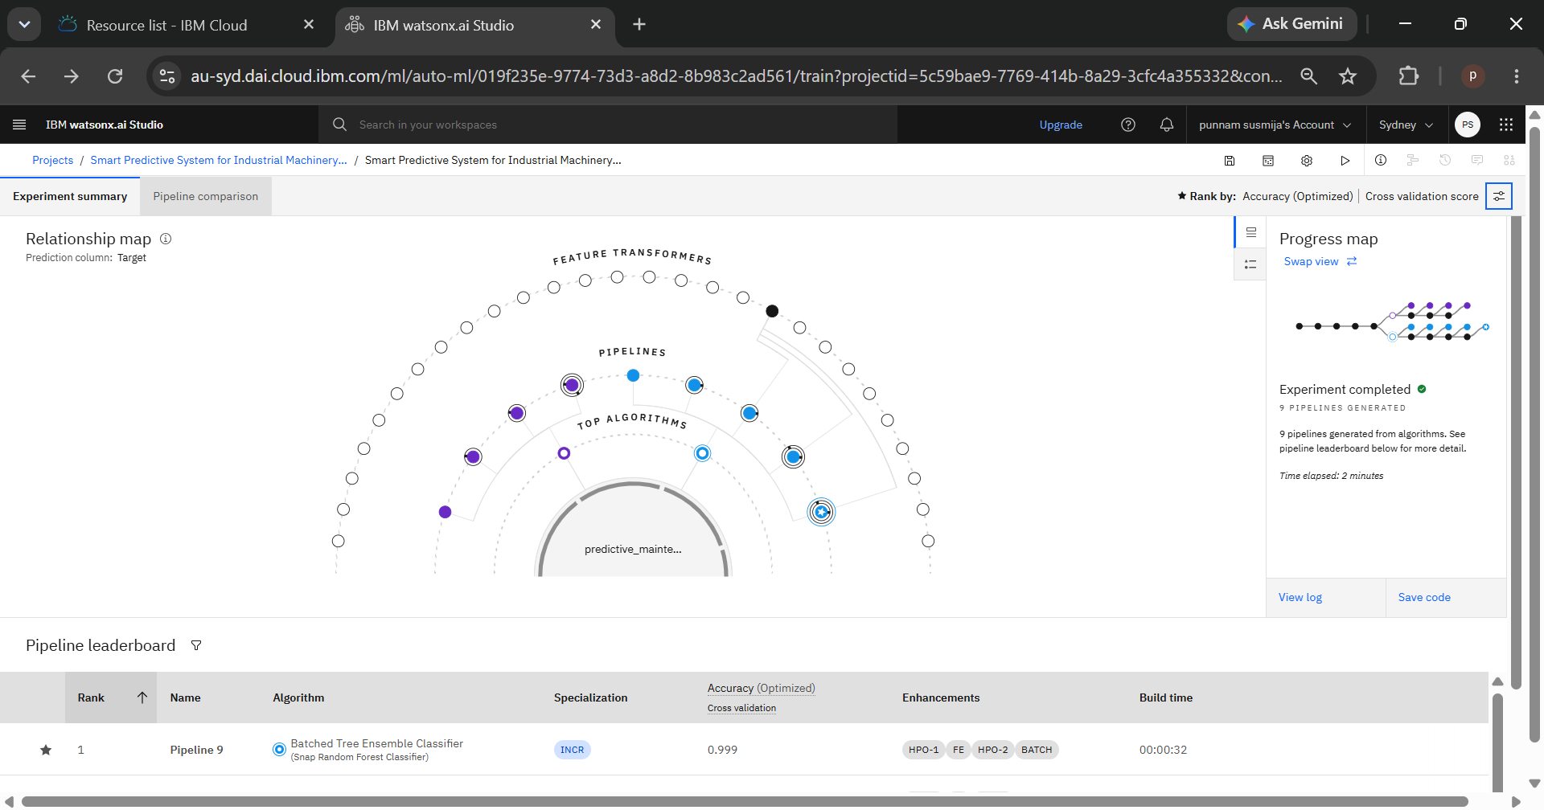
Best Model Screenshot:

Slide 8
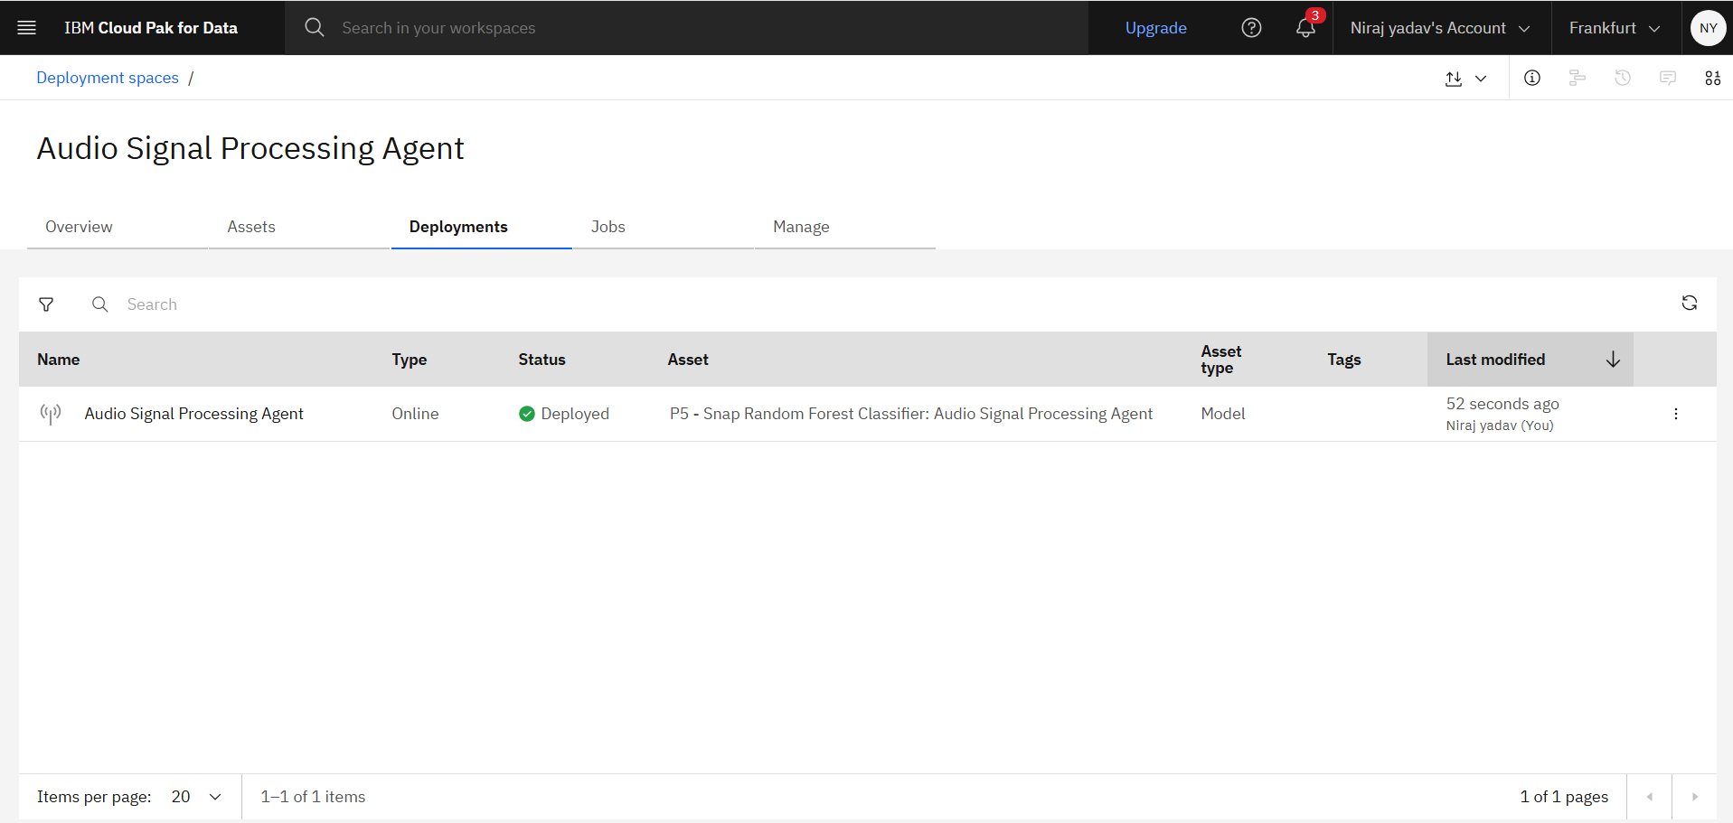
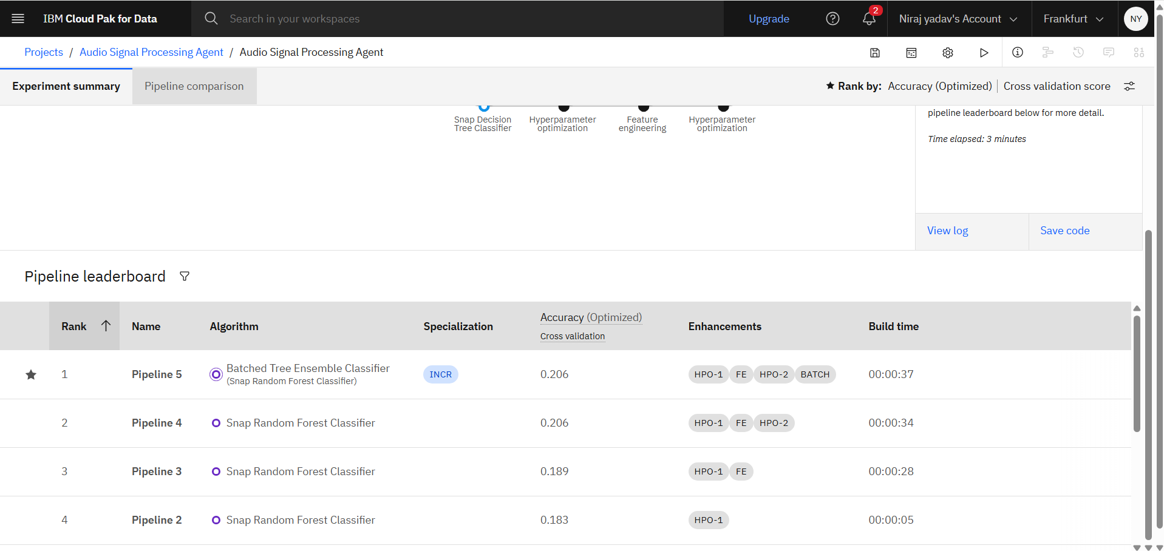
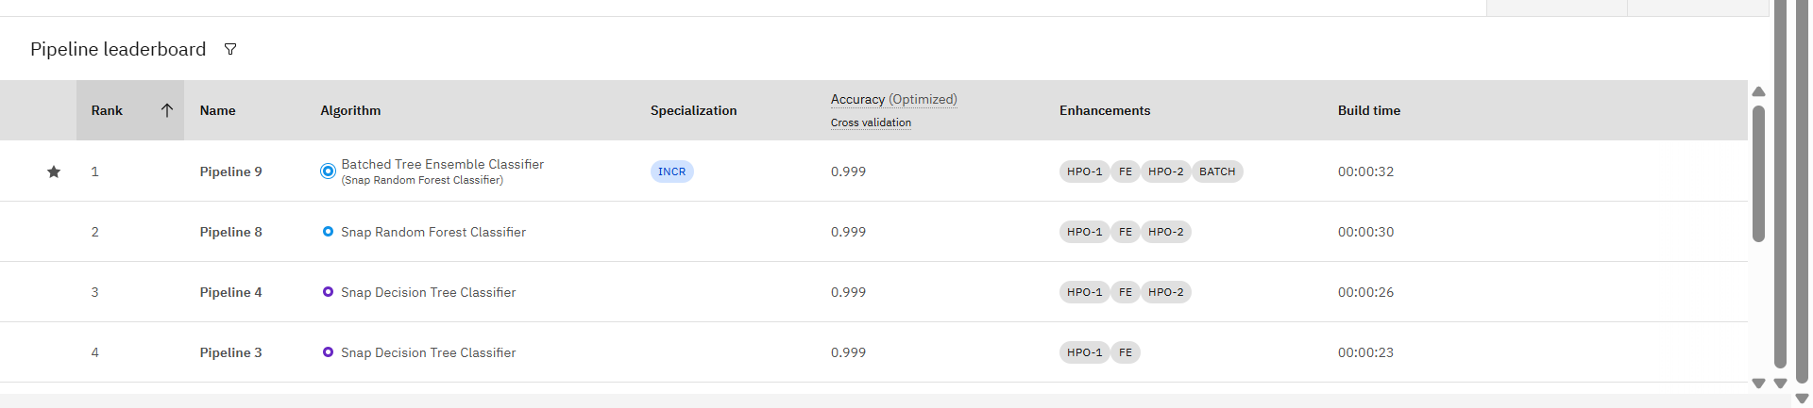
Best Model Screenshot:

Slide 9
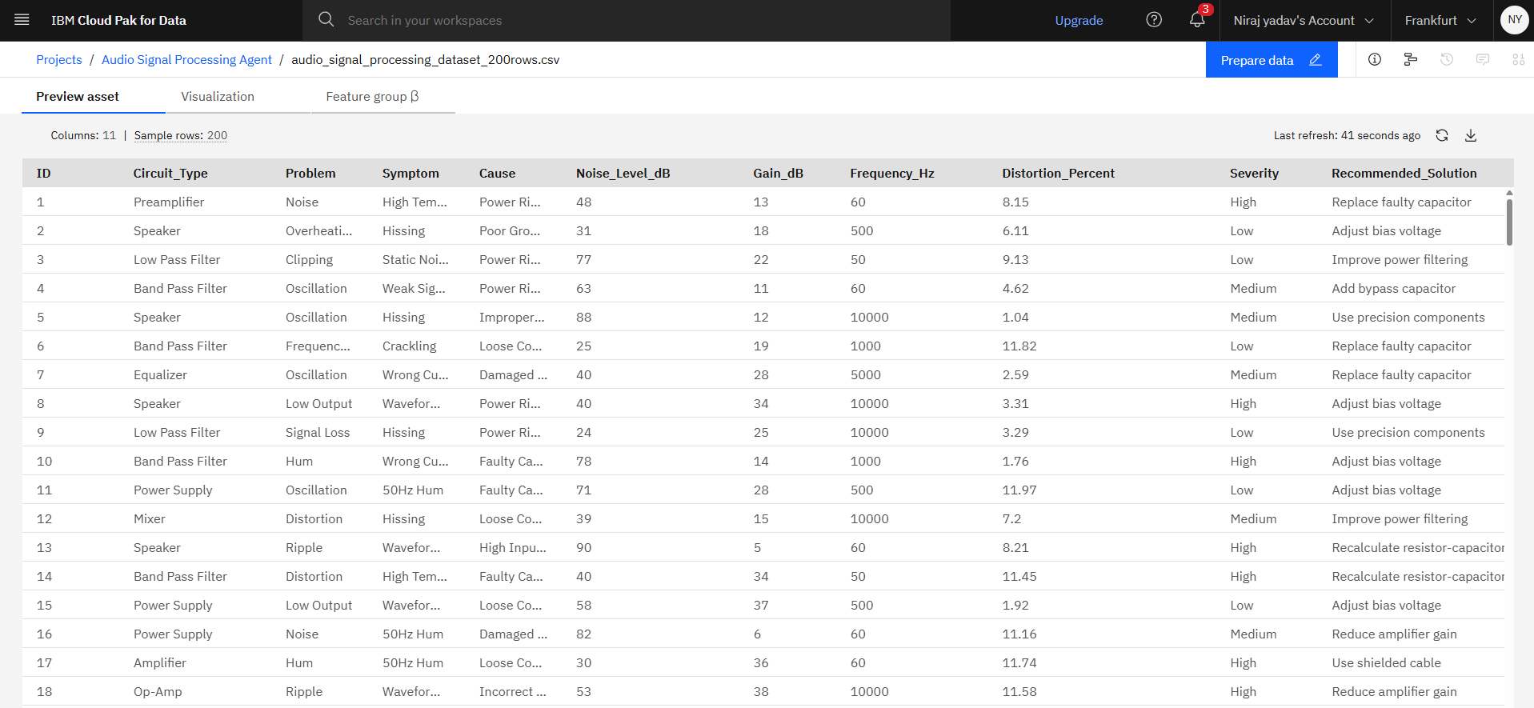
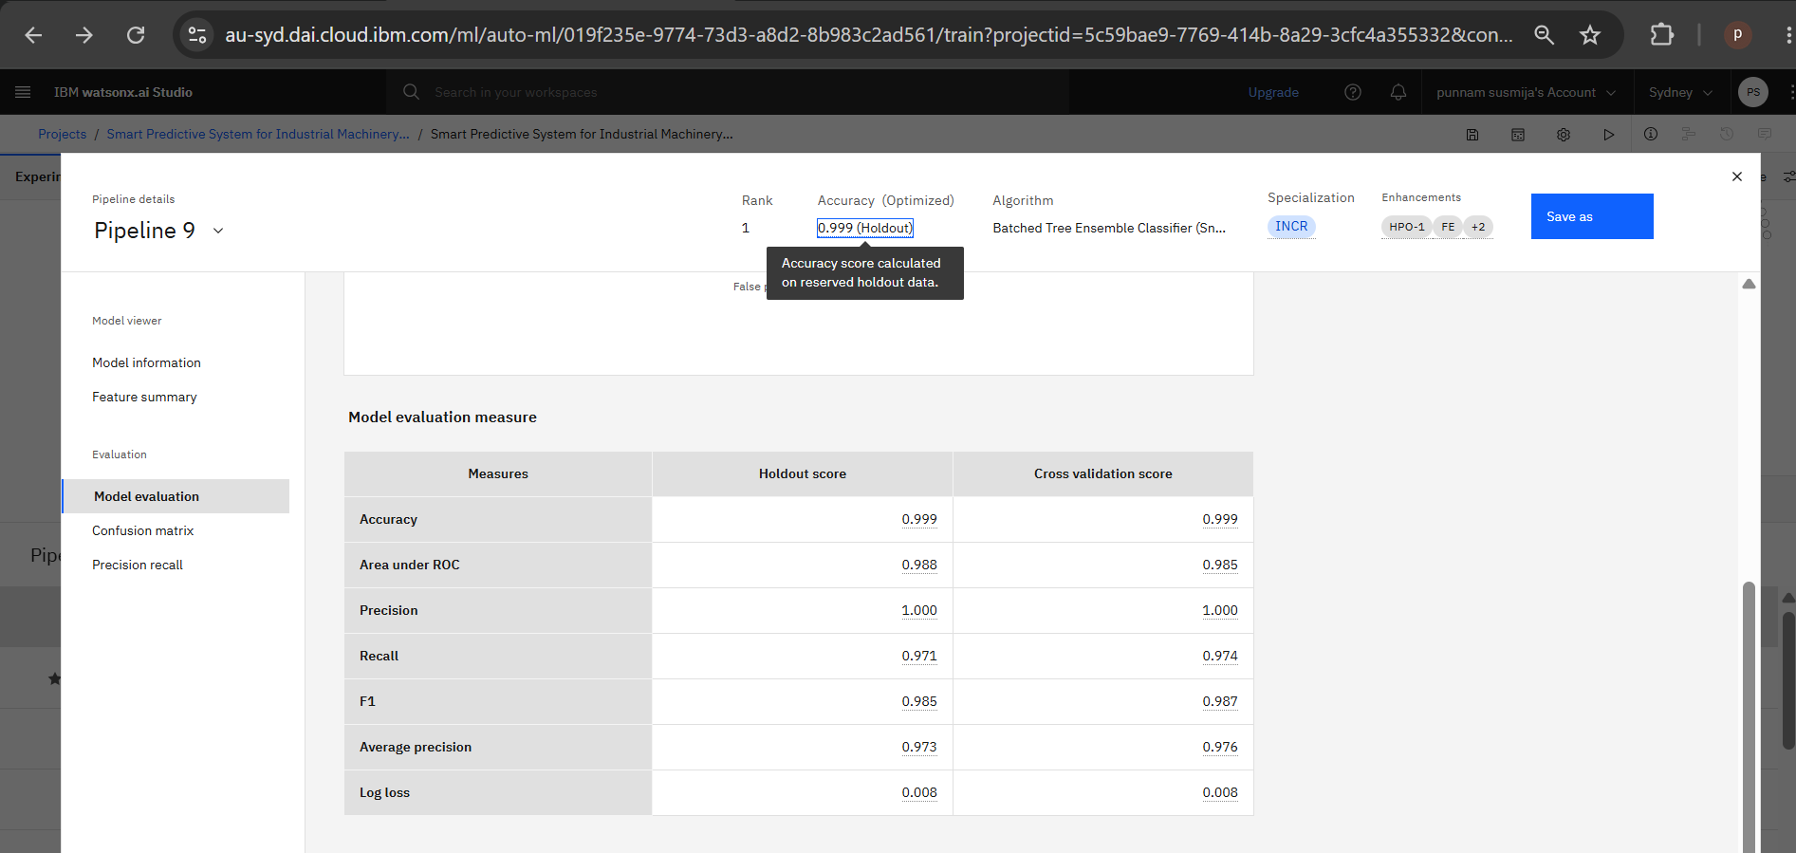
Model Evaluation Result -

Slide 10
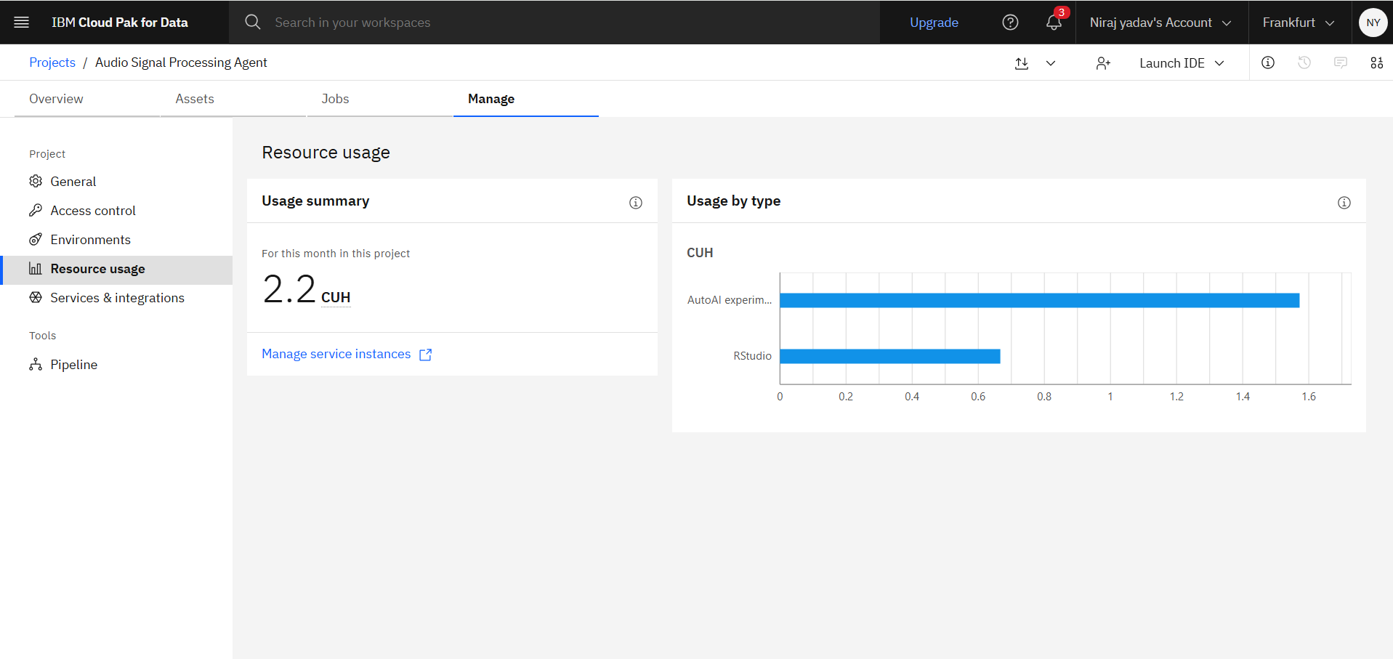
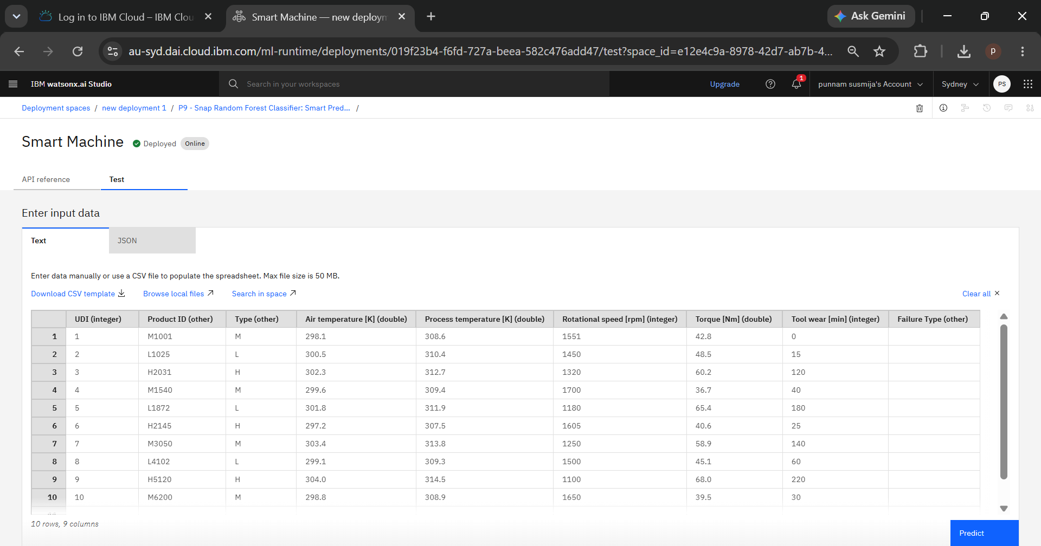

Slide 11
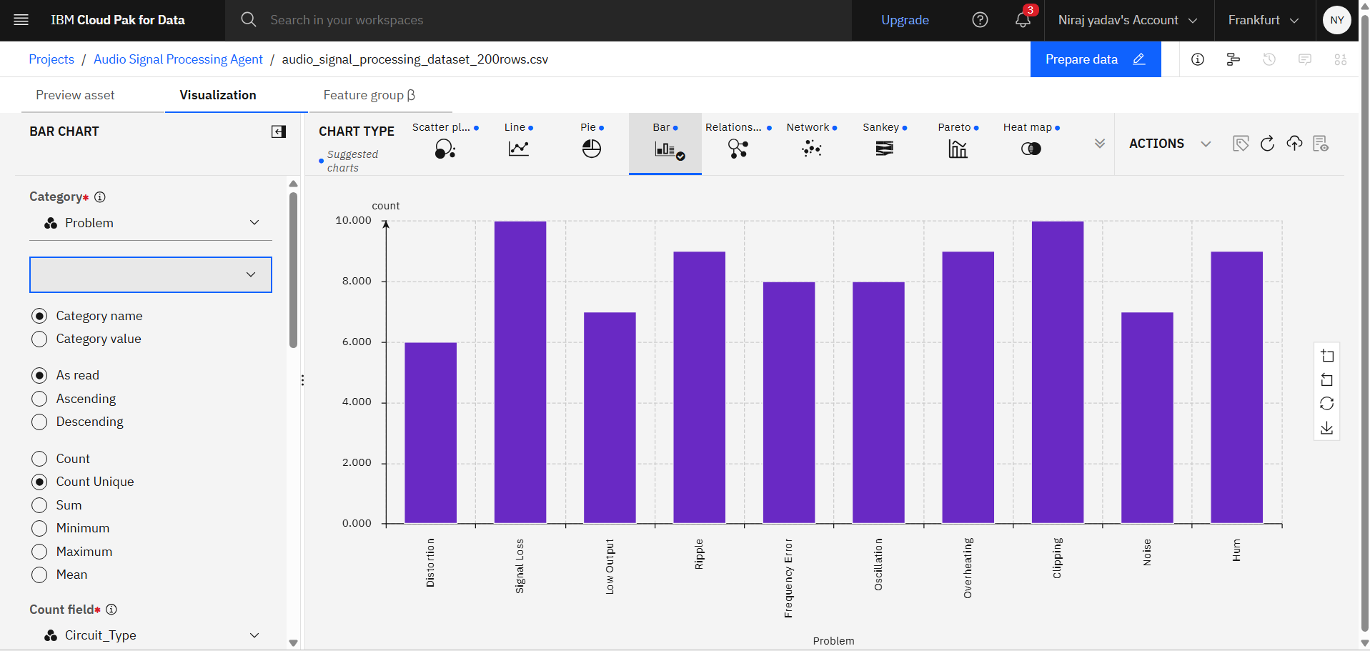
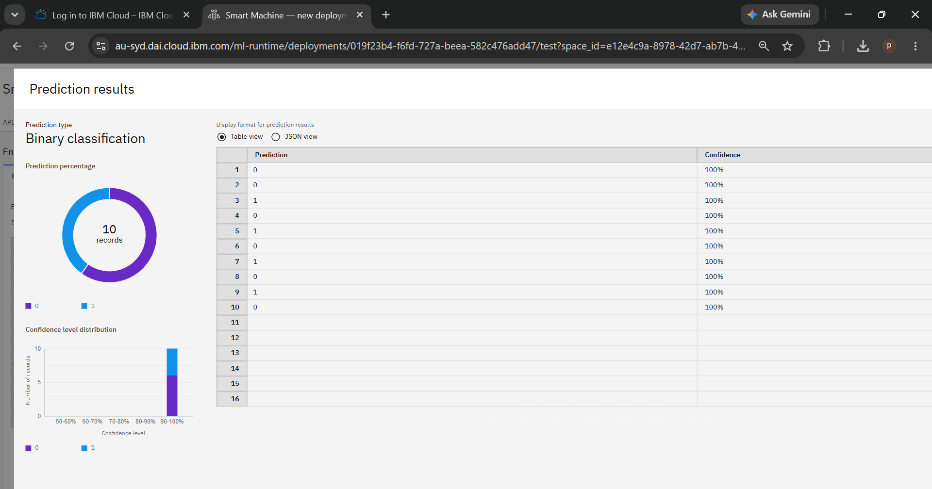

Slide 12
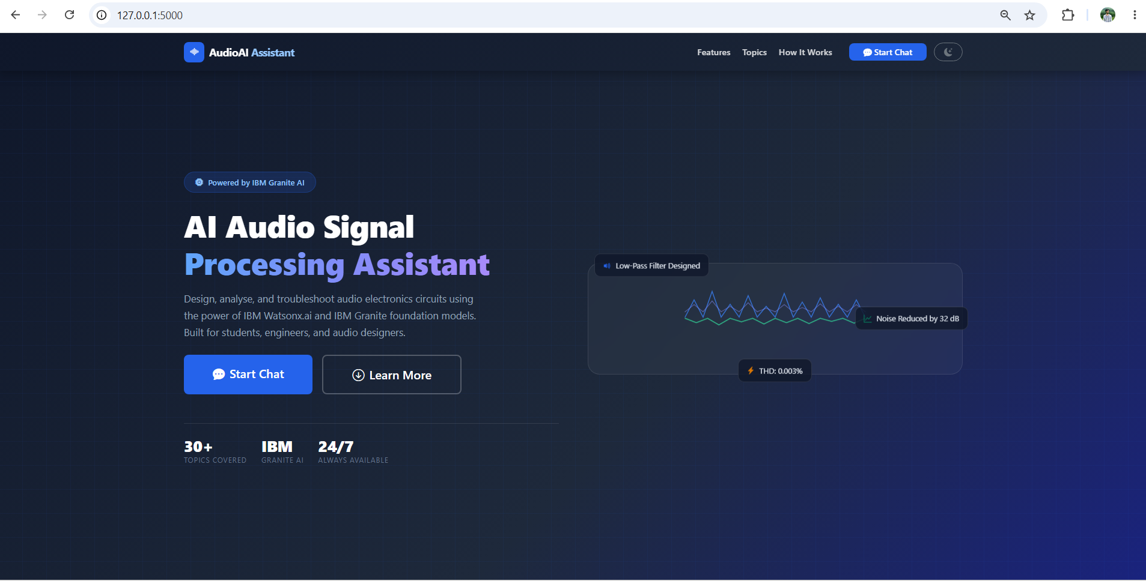
Project demo

Slide 13
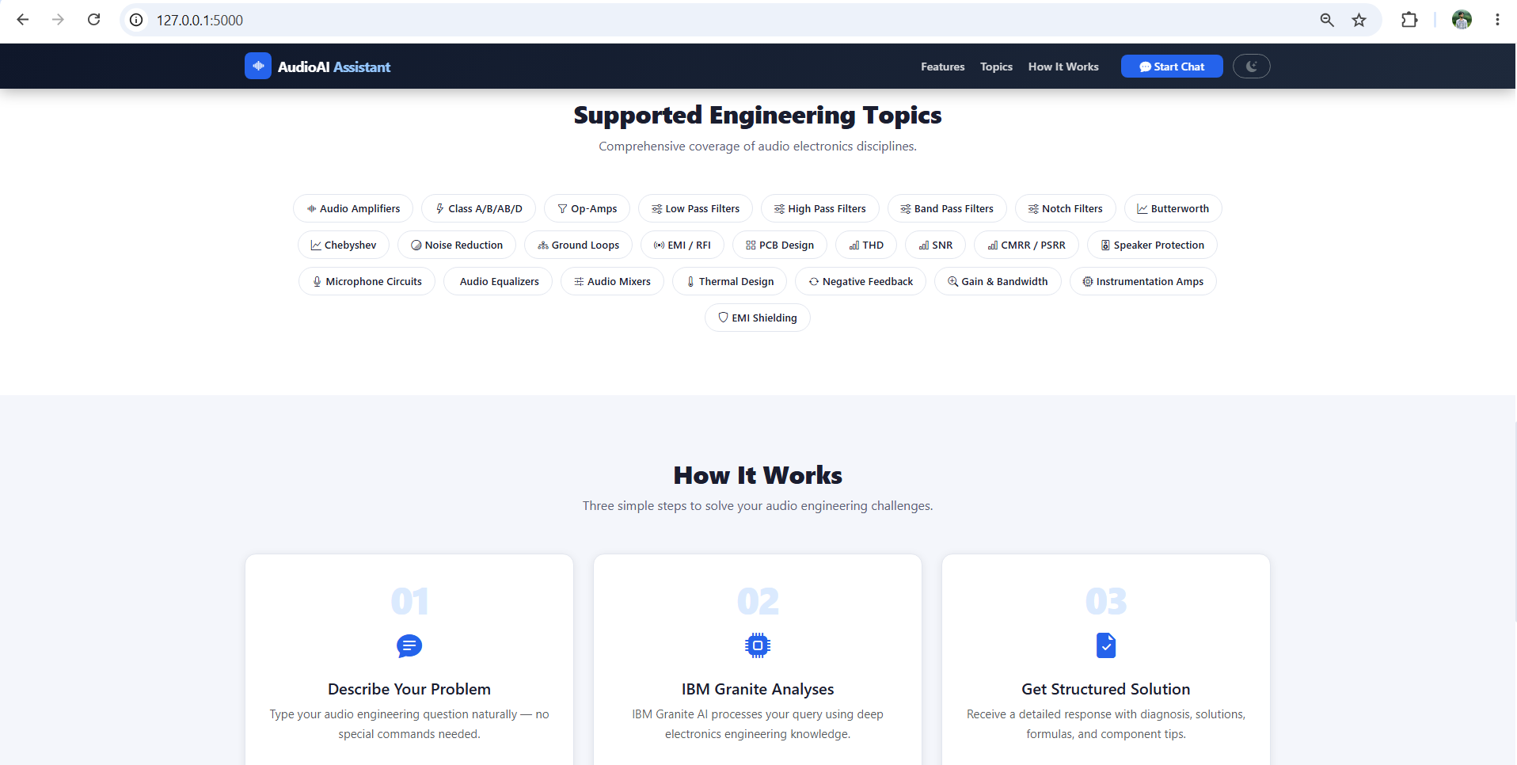

Slide 15
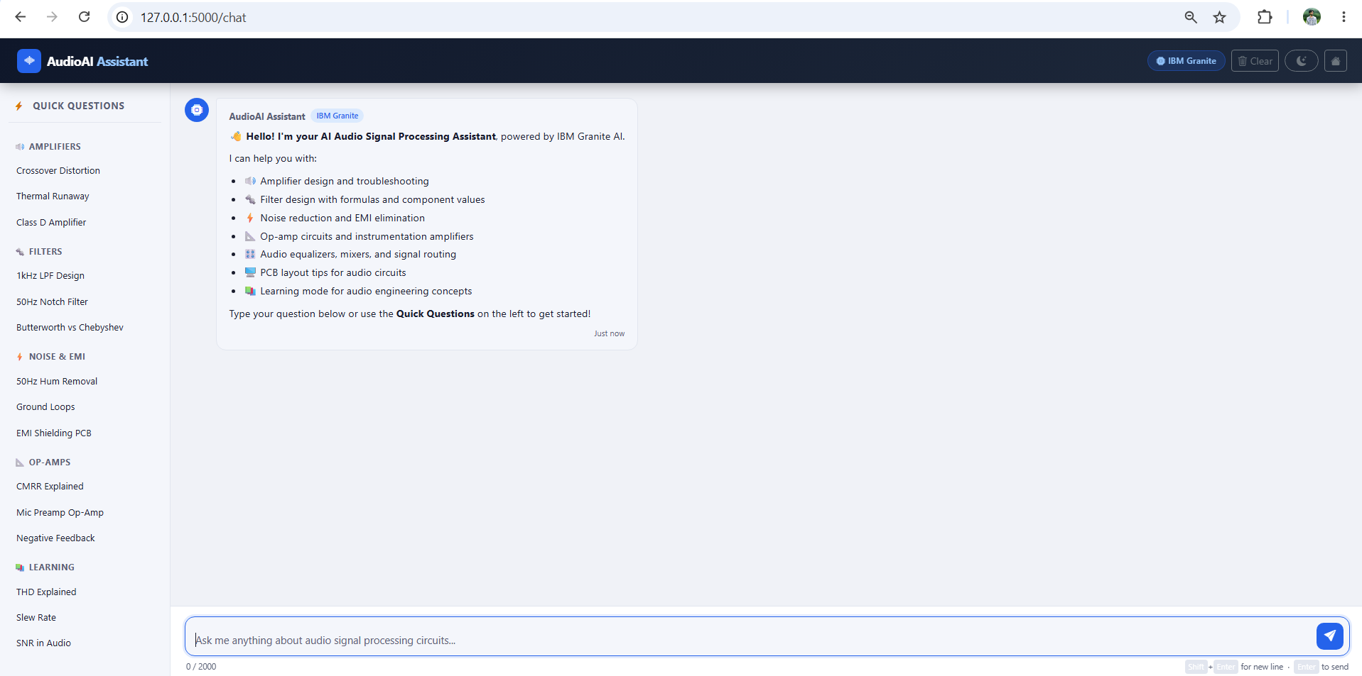

Slide 16
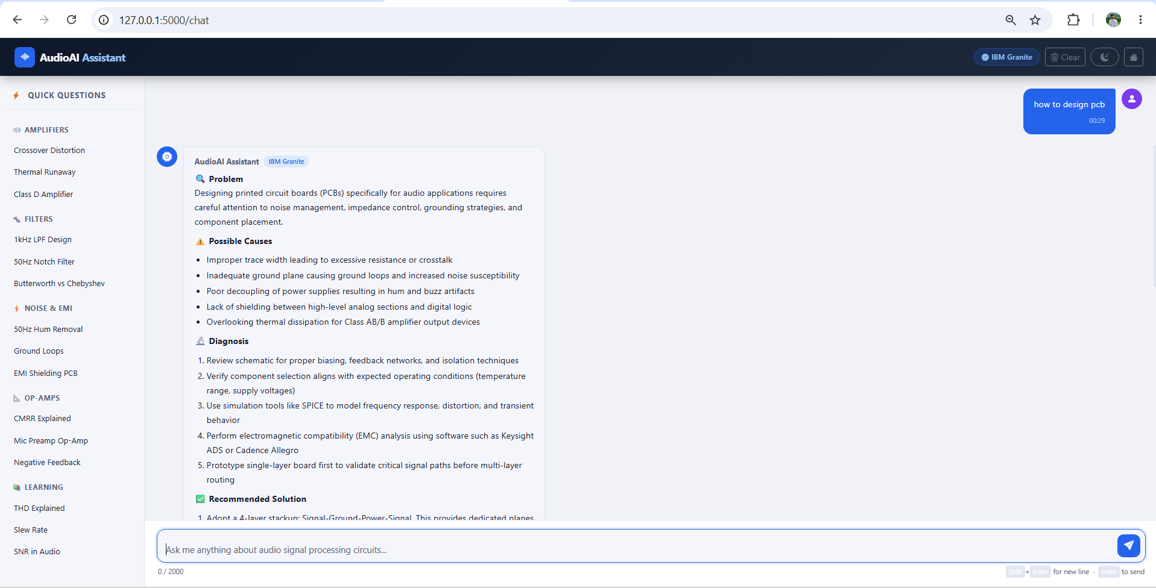

Slide 17
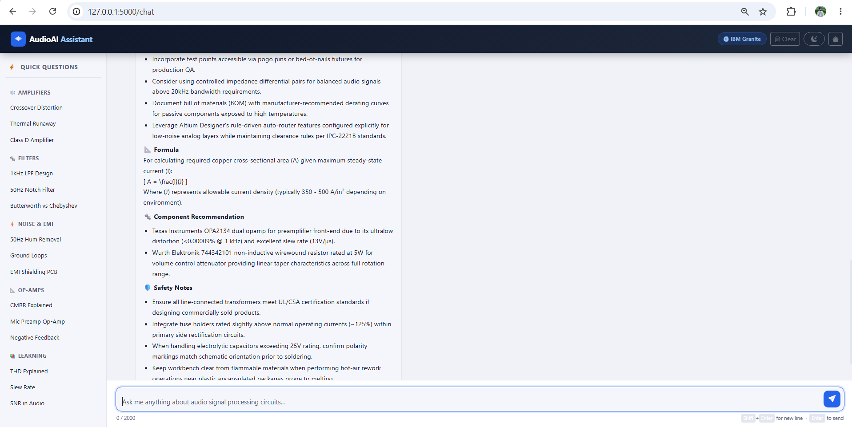

Slide 18
Novelty and Uniqueness
The proposed Audio Signal Processing Assistant provides intelligent AI-based troubleshooting for electronics and audio circuit design.
Key features include:
AI-powered technical guidance
Automatic circuit problem analysis
Noise and distortion troubleshooting
Filter design recommendations
Component selection assistance
User-friendly web interface
Fast and accurate responses using IBM Granite AI
The system significantly reduces debugging time and improves learning for students and engineers.

Slide 19
Git Hub Link
Please create public github repository (Enable Add README button while creating repository) with format –
Please test and Paste the working Github URL – https://github.com/nirajdevtech/Audio-Signal-Processing-Agent
Make sure you have Uploaded following three files into your github repository 1) App.js
2) your problem statement.pdf file
3) your project presntation.pptx file
·
·
·

Slide 20
Future Scope
Voice-enabled assistant
Audio waveform analysis
PCB fault detection
LTspice integration
Oscilloscope signal interpretation
Mobile application
IoT-based hardware diagnostics
Multi-language support
Real-time circuit simulation

Slide 21
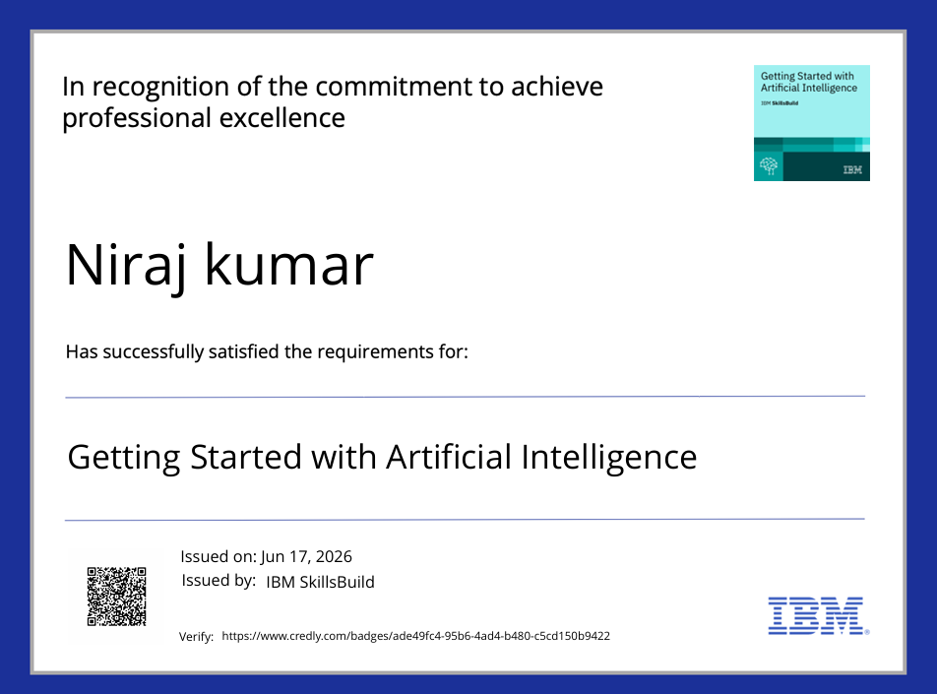
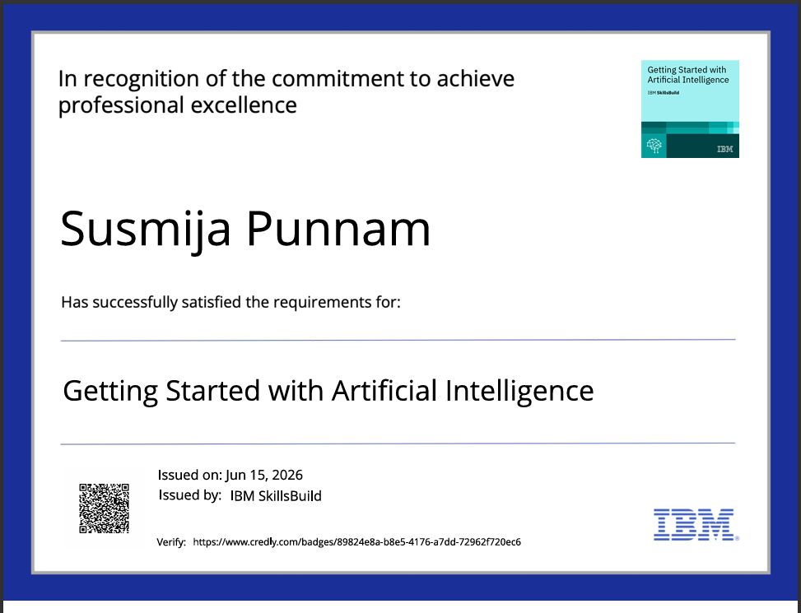
Certificates Earned:
Getting Started with Artificial Intelligence credly certificate

Slide 22
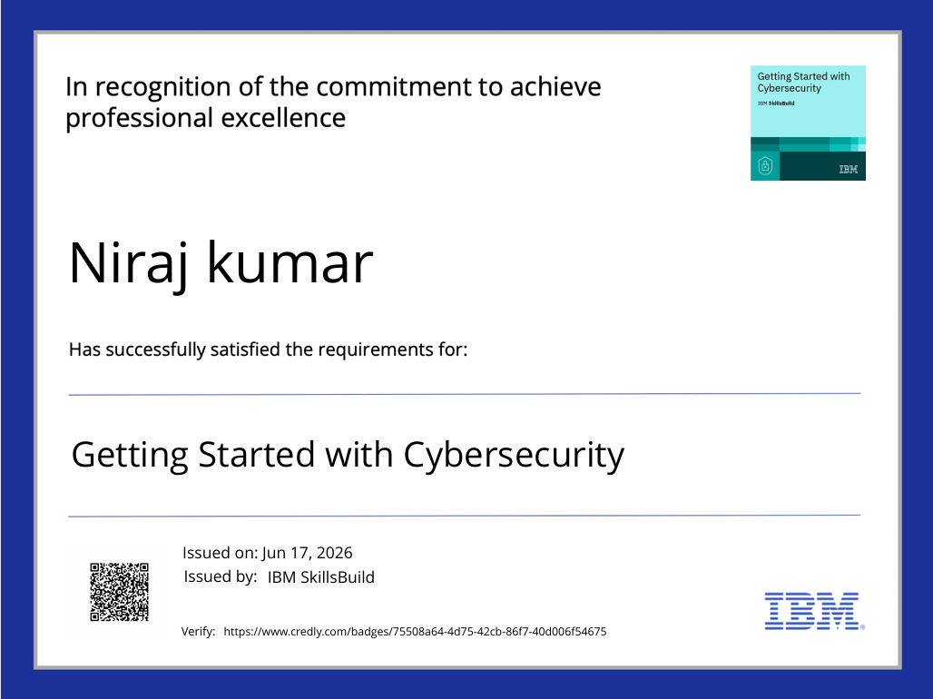
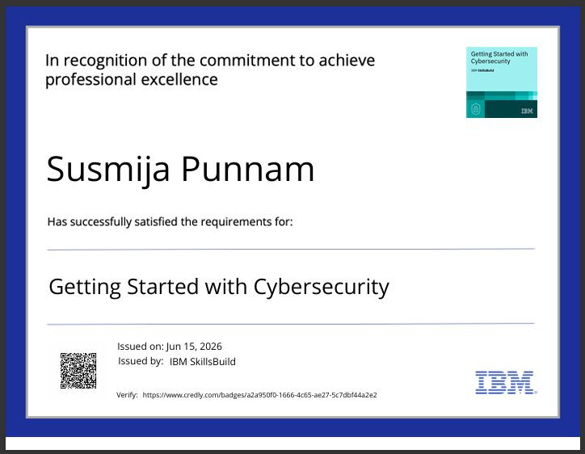
Certificates Earned:
Getting Started with Artificial Intelligence credly certificate

Slide 23
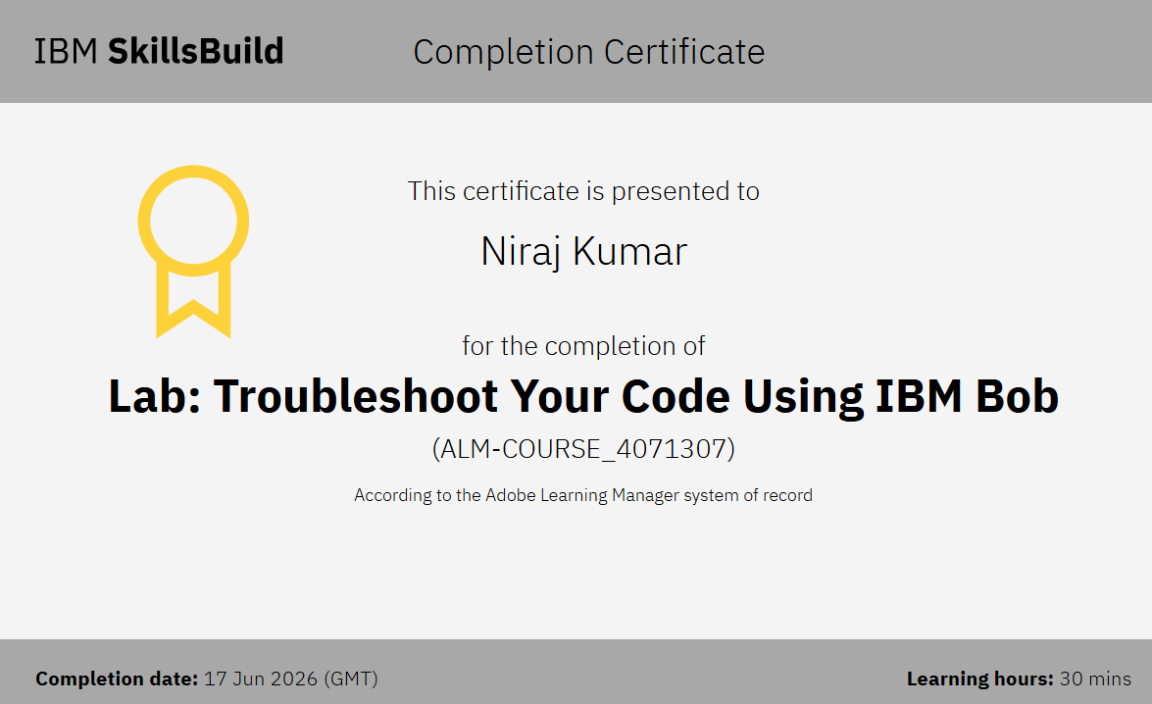
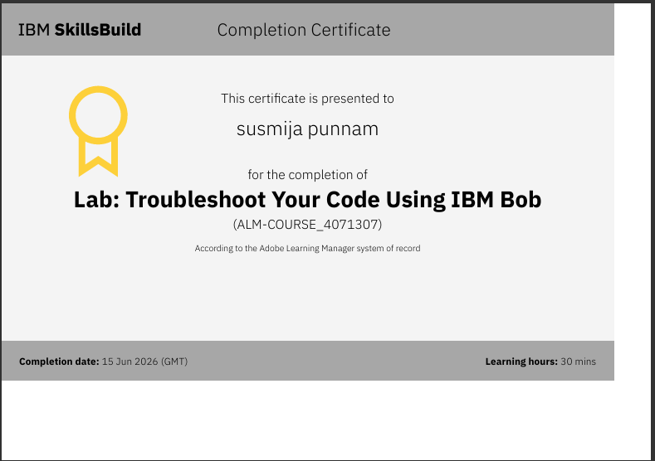
Certificates Earned:​
IBM BOB Certificate

Slide 24
Thank You!!!

